Slide 1
School Growth Plan
Windrem Elementary School
2026-2027
Notes:
Co-created with staff on June 26, 2026

Slide 2
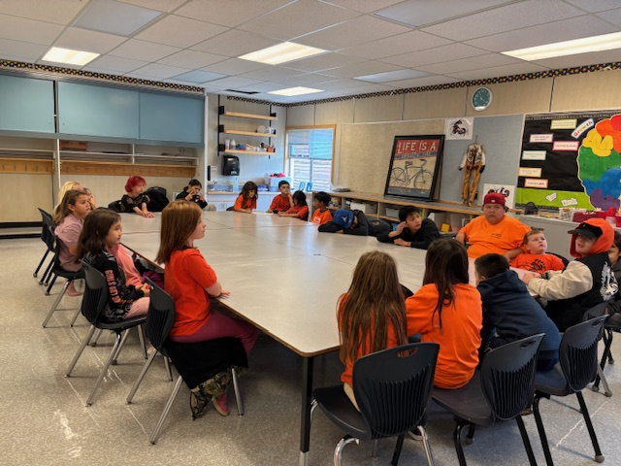
Successes
KM Club – two days better than three & prizes were motivating
School Culture – big shift over the year, moving towards intrinsic motivation, everyone is inclusive and kind.
Family Gym Nights – Helped build connection
Guided by our Goals – we worked with intention to grow in, and achieve our goals
Literacy Growth – Large reading level jumps this year for a number of students.

Slide 3
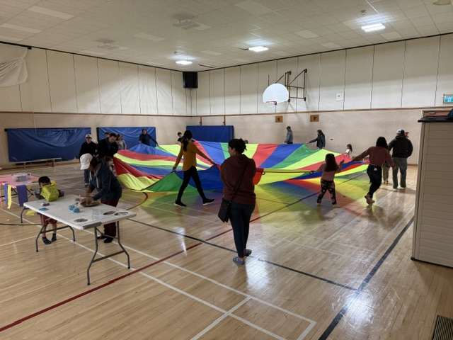
Areas for Growth
Instruction – use of evidence-based instruction, integrity in use of instructional time, making no bus days meaningful. Managing multi-grade classes has been challenging.
Student Leadership– working towards a leadership identity in intermediate grades.
Digital Numeracy Platform – IXL underused, look at different program possibly.
PHE – building staff capacity to develop structured sport units & opportunities. Managing multi-grade classes has been a challenge in this area.

Slide 4
2026-2027: Goal One
Sense of Belonging
Rationale
When students feel that they belong, we will see an increase in community engagement and motivation to learn and achieve.
Success Criteria
Attendance increases – goal of 90% attendance each month.
Staff & students recognize the gifts of others and how they contribute to our community.
Students have agency in their learning journey and are supported in meeting their needs.

Slide 5
Goal one: Strategies
Supporting grade 3 transition to intermediate environment
Opportunities for intermediate leadership
Student-led community wide events; spirit days, family gym nights, monthly celebrations of learning, hot lunch.
Communication of attendance goals – Email, newsletter, Facebook, etc.
Collaborative learning community – profile meetings, training opportunities as offered
Visible Learning, RBL & UDL – using what we know works; routines, shape of the day, explicit success criteria, high expectations, social-emotional learning, clear learning intentions, co-construction, power sharing

Slide 6
2026-2027: Goal Two
Communicating Learning
Rationale
When students are confident in their learning, they can share it with others in a variety of ways including; speaking & presenting.
Success Criteria
Students can share what they are learning and reflect on their understanding.
Families have many opportunities throughout the year to view and understand their child's learning. They can recognize strengths and areas for growth through their engagement.
Students have agency in their learning journey and are supported in meeting their goals.

Slide 7
Goal two: Strategies
Monthly celebrations of learning – adjusting the monthly awards assembly routine to include space for learning showcases.
Visible Learning, RBL & UDL – using what we know works; routines, shape of the day, explicit success criteria, high expectations, social-emotional learning, clear learning intentions, co-construction, power sharing
Communication with families – why it’s important, what it will look like and how they can support this goal.
Engaging, performance-based activity possibilities - readers theatre, music program, holiday traditions, debate/persuasive arguments, exploring different cultures, science fair, makers space, STEM activities, human library, morning announcements, student led-morning meetings.

Slide 8
The End
Prepared by: Larissa Beattie
Consultation with staff: June 26, 2026
Communicated with staff expected, September 8, 2026

